Slide 1
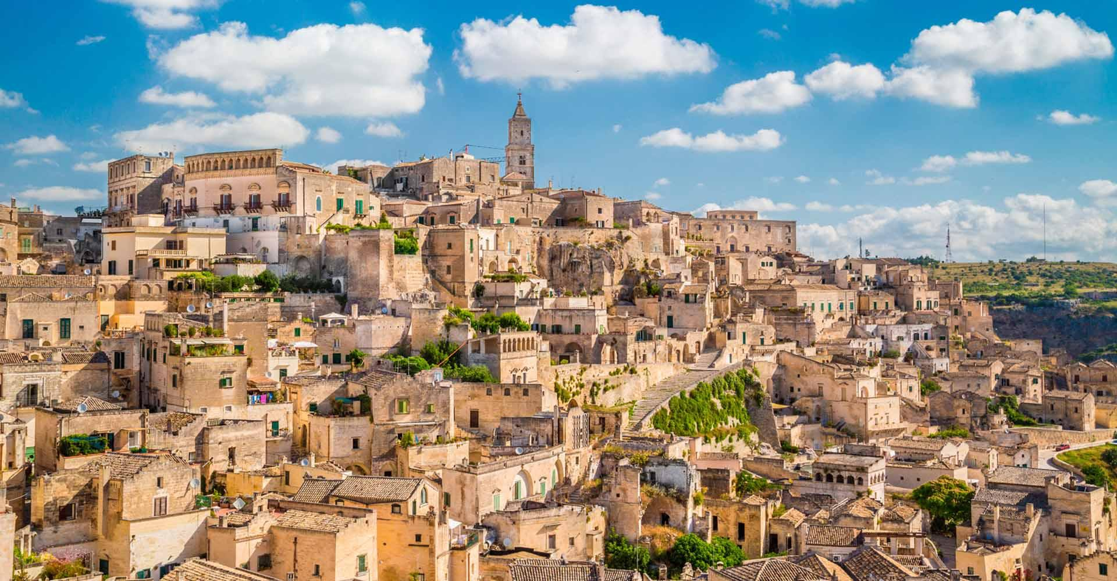

MATERA,
Italy's magical city of stone
MARIA GRAZIA CHIEFFI

Slide 2
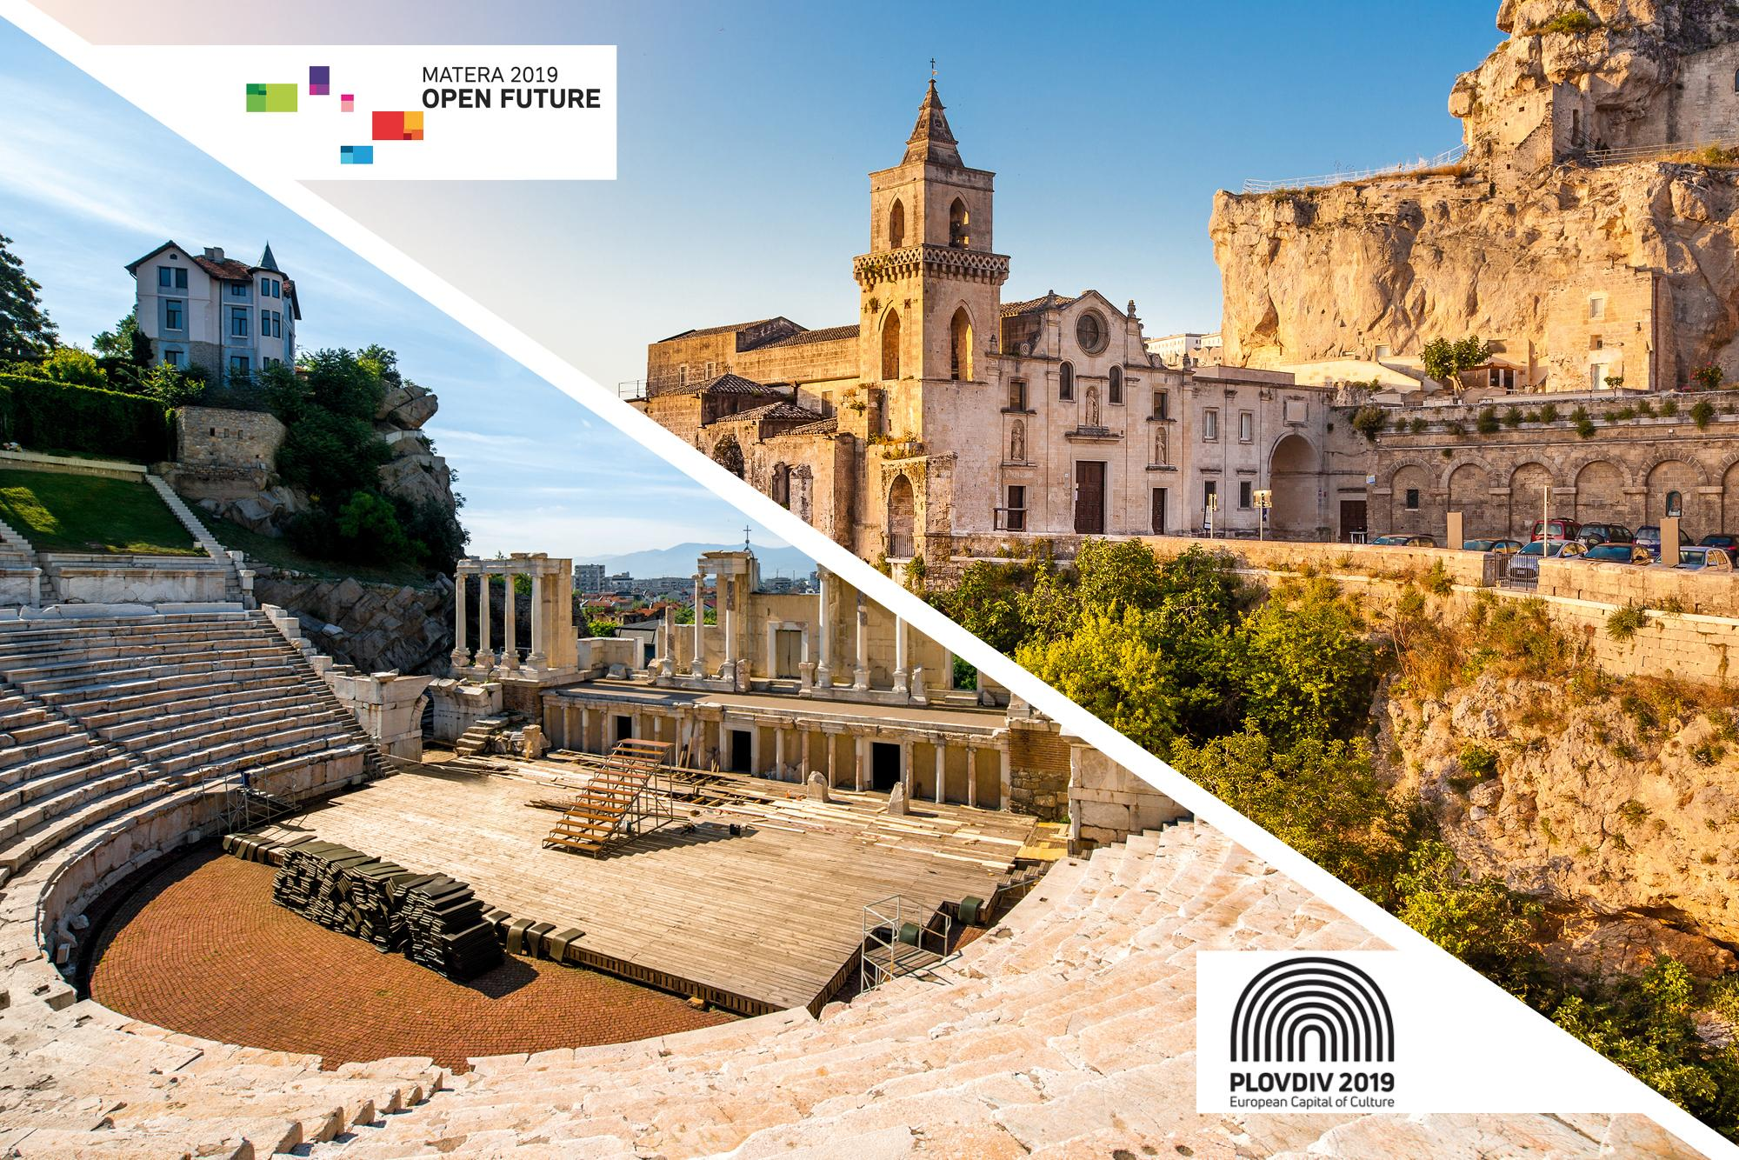
Matera, the ancient capital of Basilicata and the European Capital of Culture
MARIA GRAZIA CHIEFFI

Slide 3
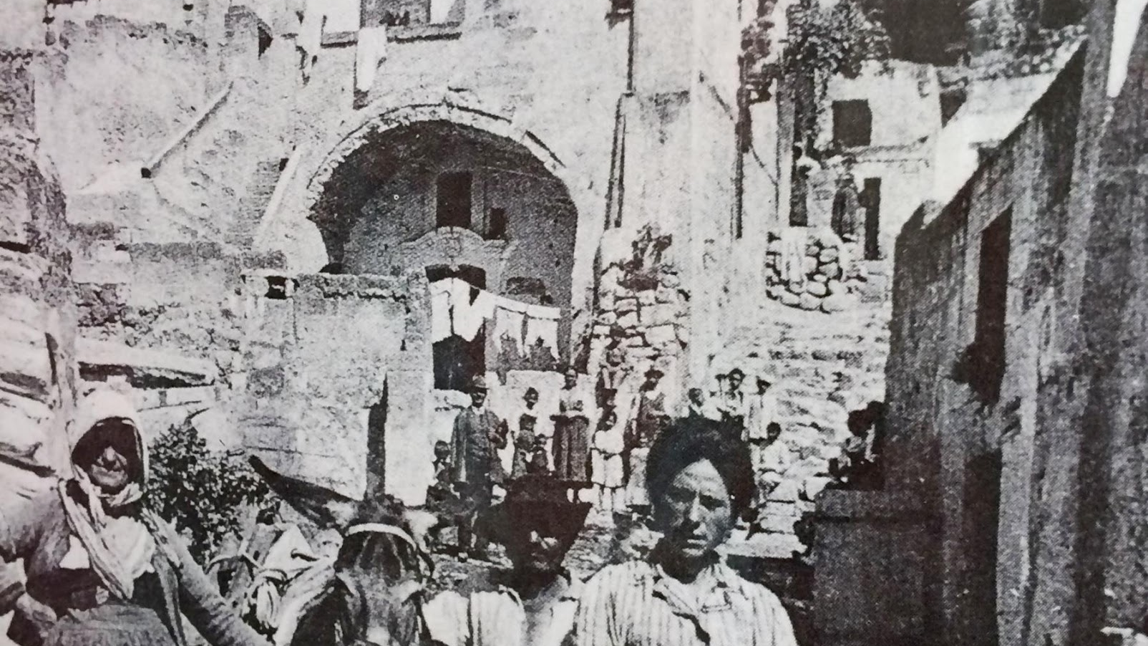
Matera was once considered the 'Shame of Italy'
Now It's a Hub for Cave-Hopping Jet-Setters. It's hard to believe that a little more than 50 years ago, Matera was the “shame of Italy,” its cave-dwelling citizens living in abject poverty without electricity or running water

Slide 4
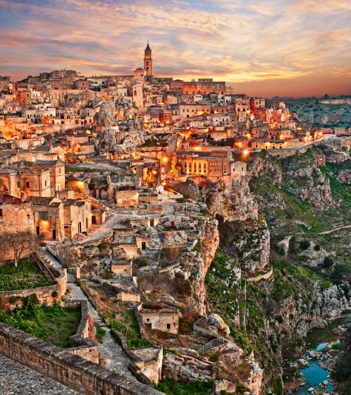
Matera, from Italy’s national disgrace to European Cultural Capital
Matera, is located in southern Italy’s Basilicata region. It was designated a UNESCO World Heritage Site in 1993; UNESCO described it as the “most outstanding, intact example of a troglodyte settlement in the Mediterranean region.” It also has been designated a European Cultural Capital for 2019 and will host cultural events expected to draw thousands of visitors.

Slide 5
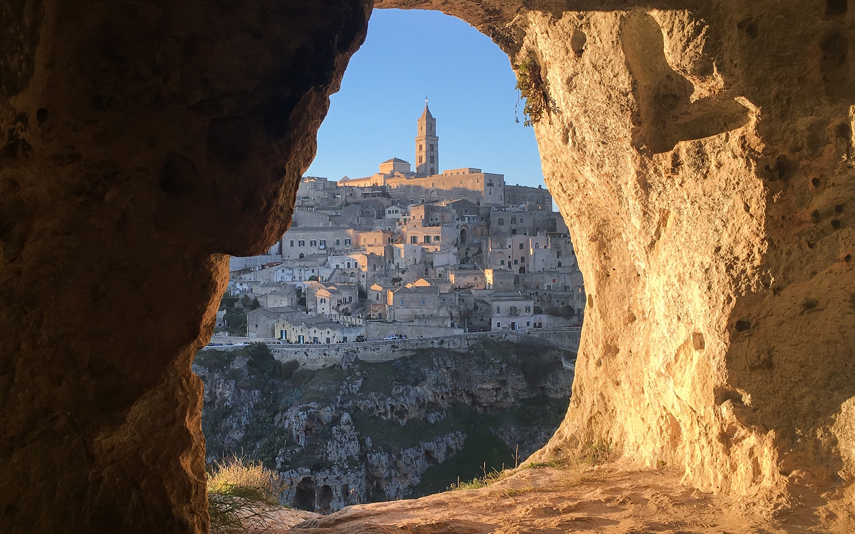
So is it worth going to visit?
“The greatness of this city is that survived all the way from the Paleolithic times,”
Matera is very easy on the eye. Imagine a scene of hillside stone houses, so compact that sometimes on sits on top of the other. Its ancient style has a sort of mysterious grandeur with a mix of cave churches carved into the montain and ornate grand churches in the old town.
Bronze Age evidence of human existance in the area for the past 9000 years makes this one of the oldest inhabited cities in the world.

Slide 6
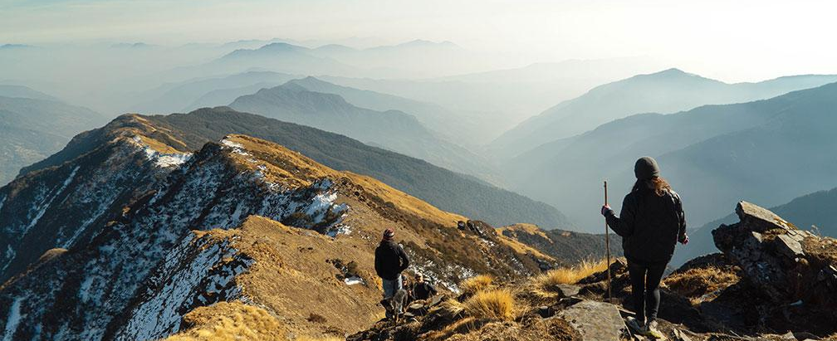

Matera, the change
From shame …
… to chic
Yet not so long ago, overpopulation, disease and poverty created terrible living conditions and hygiene issue.
The situation was so bad that the town hall evacuated the 20000 inabitants and moved them into modern accomodation far from the town centre.
Now, after renovation it is bound to become the next must-visit city.

Slide 7
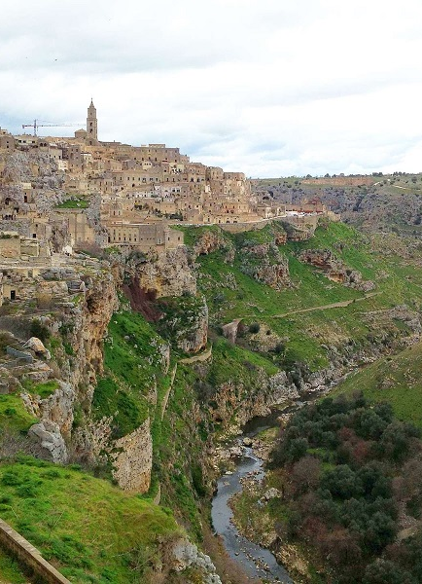
Go for a walk
Matera is divided into to :
the civita – the town centre;
sorrounding sassi cliffs
It’s a walk of steep ups and downs and highlights include the sensational views especially from Parco della Murgia Materana, the National park

Slide 8
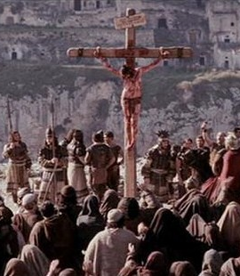
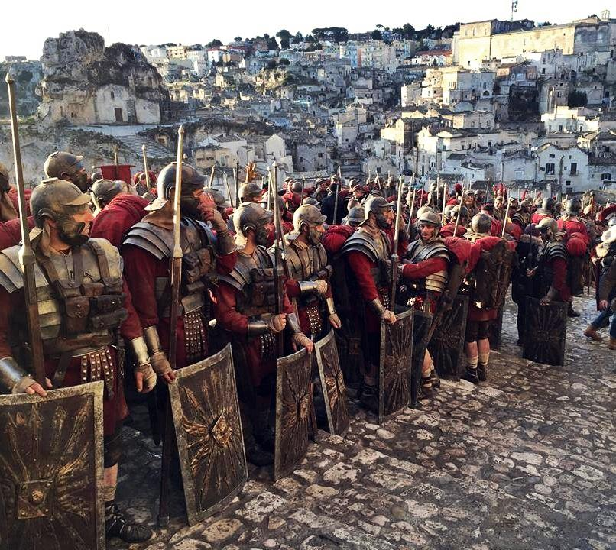
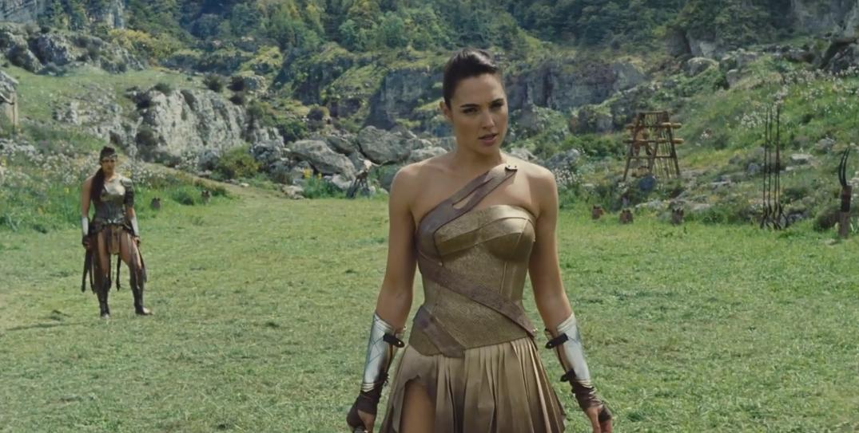
Film fame
“ideal place for movie shooting”
It’s not surprising that Mel Gibson chose to film his “ Passion of Christ”in 2003.
More recently a new Wonder Woman film and the ben Hur spectacular starring Morgan Freeman and Jack Huston were both in Matera

Slide 9
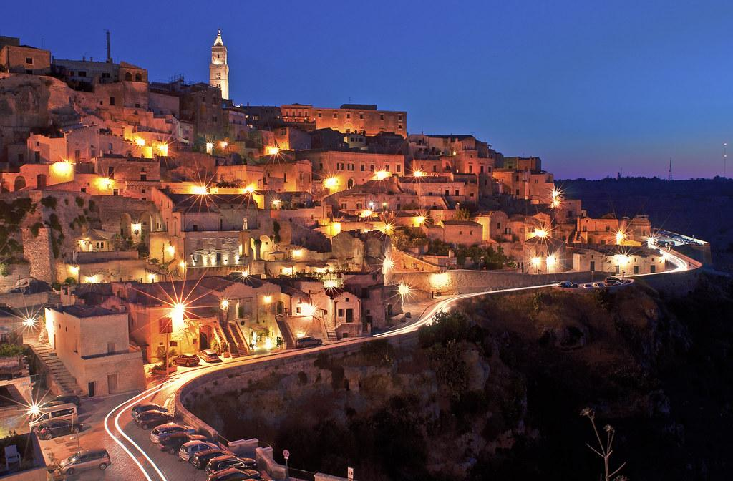

Thanks for your attention!
MARIA GRAZIA CHIEFFI

